Slide 1
BDD
Lesson – 4 : Cucumber – Introduction

Slide 2
Lesson Objectives
In this lesson, you will learn:
Cucumber Framework
How it Works
Advantages of Cucumber
Feature File
Steps Definitions
Cucumber Options
Scenario Outline
Data Tables in Cucumber
Notes:
Reference : https://www.cs.colorado.edu/~kena/classes/5828/s12/lectures/09-bddcucumber.pdf

Slide 3
Cucumber Framework
Cucumber is one such open source tool, which supports behavior driven development
Cucumber is a software requirements and testing tool that enables a style of development that builds on the principles of test-driven development
Cucumber reads the code written in plain English text (Language Gherkin) in the feature file
It finds the exact match of each step in the step definition
Cucumber supports over a dozen different software platforms like −
Ruby on Rails
Selenium
PicoContainer
Spring Framework
Watir
Notes:
Cucumber is one such open source tool, which supports behavior driven development. To be more precise, Cucumber can be defined as a testing framework, driven by plain English text. It serves as documentation, automated tests, and a development aid – all in one.
So what does Cucumber do? It can be described in the following steps −
Cucumber reads the code written in plain English text (Language Gherkin – to be introduced later in this tutorial) in the feature file (to be introduced later).
It finds the exact match of each step in the step definition (a code file - details provided later in the tutorial).
The piece of code to be executed can be different software frameworks like Selenium, Ruby on Rails, etc.
Not every BDD framework tool supports every tool.
This has become the reason for Cucumber's popularity over other frameworks, like JBehave, JDave, Easyb, etc.
Cucumber supports over a dozen different software platforms like −
Ruby on Rails
Selenium
PicoContainer
Spring Framework
Watir

Slide 4
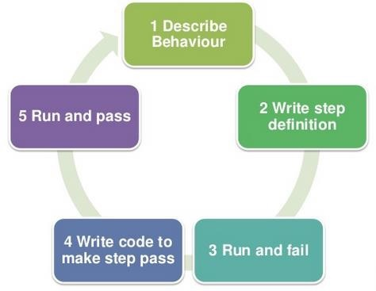
How it Works

Slide 5
Advantages of Cucumber
Cucumber supports different languages like Java.net and Ruby.
It acts as a bridge between the business and technical language. We can accomplish this by creating a test case in plain English text.
It allows the test script to be written without knowledge of any code, it allows the involvement of non-programmers as well.
It serves the purpose of end-to-end test framework unlike other tools.
Due to simple test script architecture, Cucumber provides code reusability.
Notes:
Reference : https://www.tutorialspoint.com/cucumber/cucumber_overview.htm

Slide 6
Feature Files
A Feature can be defined as a standalone unit or functionality of a project.
Cucumber tests are written in feature files.
A feature usually contains a list of scenarios to be tested for that feature
It is advisable that there should be a separate feature file, for each feature under test.
There are no logic details written in the feature file.
The extension of the feature file needs to be “.feature”.
For Example:
Sr.No | Feature | Feature File name
1 | User Login | userLogin.feature
2 | Share the Post | sharePost.feature
3 | Create Account | createAccount.feature
4 | Delete Account | deleteAccount.feature

Slide 7
Feature Files
Example
Feature: Login functionality for a social networking site. The user should be able to login into the social networking site if the username and the password are correct. The user should be shown the error message if the username and the password are incorrect. The user should be navigated to home page, if the username and password are correct.
In Feature file it will be written with Gherkin keywords as below:
Feature: Login functionality for a social networking site. Given I am a social networking site user. When I enter username as username1. And I enter password as password1. Then I should be redirected to the home page of the site.
The above-mentioned scenario is of a feature called user login.
All the words highlighted in bold are Gherkin keywords.

Slide 8
Feature Files
A simple feature file consists of the following keywords/parts −
Feature − Name of the feature under test.
Description (optional) − Describe about feature under test.
Scenario − What is the test scenario.
Given − Prerequisite before the test steps get executed.
When − Specific condition which should match in order to execute the next step.
Then − What should happen if the condition mentioned in WHEN is satisfied.
Notes:
Example
Feature − User login on social networking site.
The user should be able to login into the social networking site when the username and the password are correct.
The user should be shown an error message when the username and the password are incorrect.
The user should be navigated to the home page if the username and the password are correct.
Outline − Login functionality for a social networking site.
The given user navigates to Facebook. When I enter Username as "<username>" and Password as "<password>". Then, login should be unsuccessful.
| username | password | | username1 | password1 | * AND keyword is used to show conjunction between two conditions. AND can be used with any other keywords like GIVEN, WHEN and THEN.
There are no logic details written in the feature file.

Slide 9
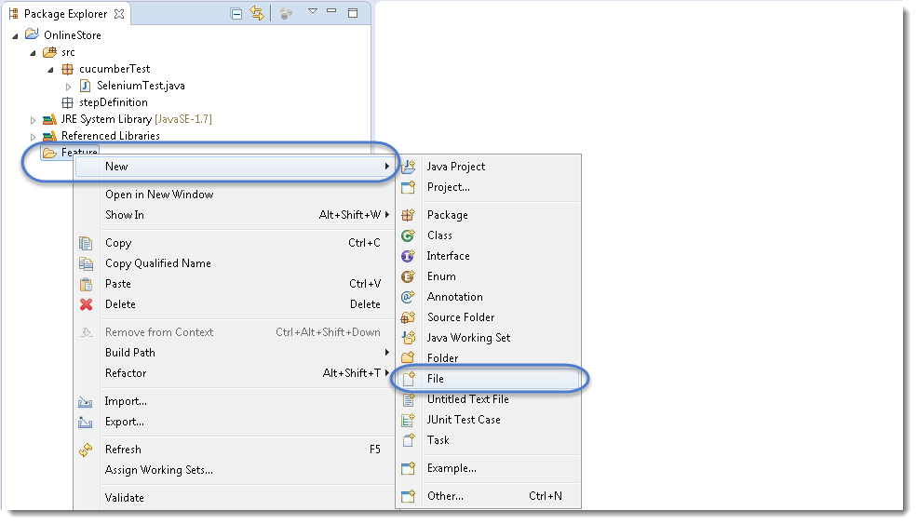
Feature File
1) On the Feature folder Right click and select New > File

Slide 10
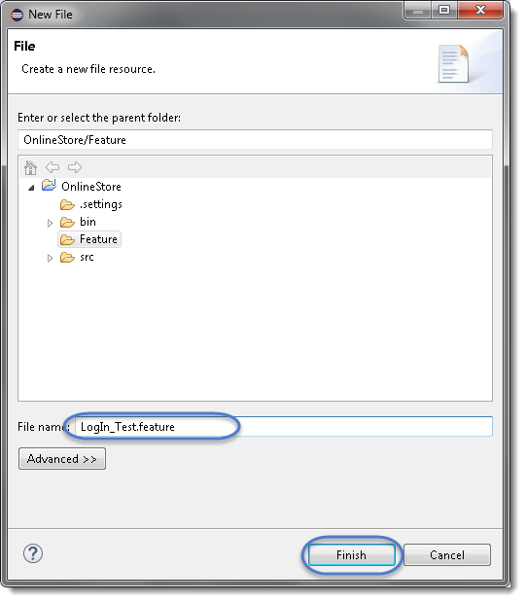
Feature File
2) In order for Cucumber to automatically detect the stories (or features, as they’re known in Cucumber), you need to make sure that they carry the ‘.feature‘ file extension.
For example, in this case, I’ve named my user story ‘LogIn_Test.feature‘.
Every ‘.feature‘ file conventionally consists of a single feature

Slide 11
Feature File
3) Write the first cucumber script. In BDD terms the scenario would look like the following.
Cucumber Test Script
1 2 3 4 5 6 7 8 9 10 11 | Feature: Login Action Scenario: Successful Login with Valid Credentials Given User is on Home Page When User Navigate to LogIn Page And User enters UserName and Password Then Message displayed Login Successfully Scenario: Successful LogOut When User LogOut from the Application Then Message displayed LogOut Successfully

Slide 12
Steps Definitions
Steps definition file stores the mapping between each step of the scenario defined in the feature file with a code of function to be executed.
When Cucumber executes a step of the scenario mentioned in the feature file, it scans the step definition file and figures out which function is to be called.
So with each function, whatever code you want to execute with each test step (i.e. GIVEN/THEN/WHEN), you can write it within Step Definition file.
Make sure that code/function has been defined for each of the steps.
This function can be Java functions, where we can use both Java and Selenium commands in order to automate our test steps.

Slide 13
Steps Definitions
1) Create a new Class file in the ‘stepDefinition‘ package and name it as ‘Test_Steps‘, by right click on the Package and select New > Class. Do not check the option for ‘public static void main‘ and click on Finish button.
2) Take a look at the message in the console window. This message was displayed, when we ran the Test_Runner class.

Slide 14
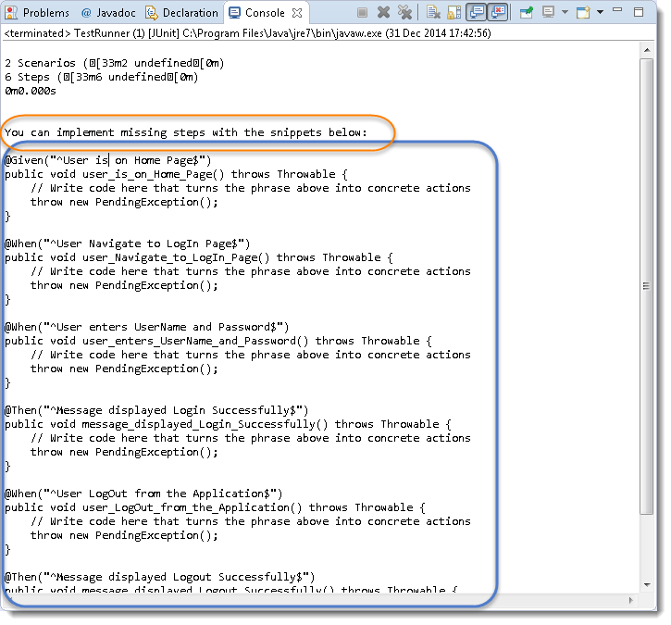
Steps Definitions

Slide 15
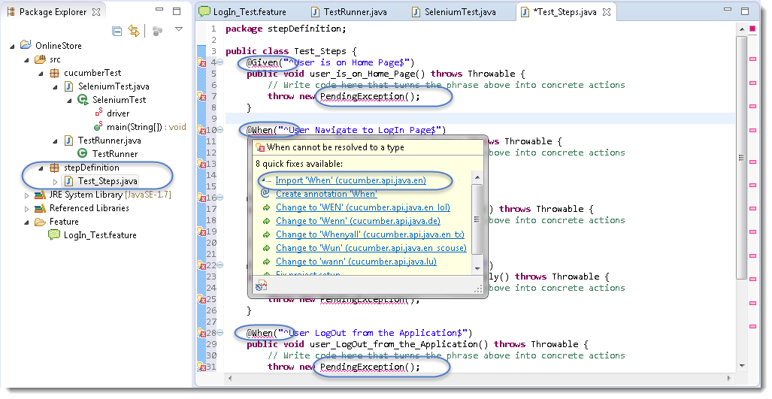
Steps Definitions
2) Notice, the eclipse console window says ‘You can implement missing steps with the snippets below:‘. It is very easy to implement all the steps, all you need to do is to copy the complete text marked in a blue box and paste it in to the above created Test_Steps class.
3) As of now the test will show many errors on ‘@‘ annotations. Mouse hover at the annotations and import the ‘cucumber.api.java.en‘ for all the annotations.

Slide 16
Cucumber Options
@CucumberOptions are like property file or settings for your test.
Basically
@CucumberOptions enables us to do all the things that we could have done if we have used cucumber command line.
This is very helpful and of utmost importance if we are using IDE such eclipse only to execute our project.
TestRunner Class
package cucumberTest;
import org.junit.runner.RunWith;
import cucumber.api.CucumberOptions;
import cucumber.api.junit.Cucumber;
@RunWith(Cucumber.class)
@CucumberOptions(
features = "Feature"
,glue={"stepDefinition"}
)
public class TestRunner {
}
Notes:
So in the above example we have just set two different Cucumber Options. One is for Feature File and other is for Step Definition file. @CucumberOptions are used to set some specific properties for the Cucumber test.

Slide 17
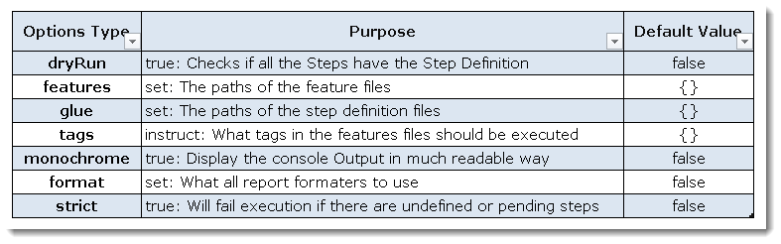
Cucumber Options
Following Main Options are available in Cucumber:
Notes:
So in the above example we have just set two different Cucumber Options. One is for Feature File and other is for Step Definition file. @CucumberOptions are used to set some specific properties for the Cucumber test.

Slide 18
Cucumber Options
Dry Run
dryRun option can either set as true or false.
If it is set as true, it means that
Cucumber will only checks that every Stepmentioned in the Feature File have corresponding code written in Step Definition file or not.
So in case any of the function is missed in the Step Definition for any Step in Feature File, it will give us the message.
Monochrome
This option can either set as true or false.
If it is set as true, it means that the console output for the Cucumber test are much more readable.
And if it is set as false, then the console outputis not as readable as it should be.
Notes:
So in the above example we have just set two different Cucumber Options. One is for Feature File and other is for Step Definition file. @CucumberOptions are used to set some specific properties for the Cucumber test.

Slide 19
Cucumber Options
Features
Features Options helps Cucumber to locate the Feature file in the project folder structure.
All we need to do is to specify the folder path and Cucumber will automatically find all the ‘.features‘ extension files in the folder.
It can be specified like:
features = “Feature“
Or if the Feature file is in the deep folder structure
features = “src/test/features“
Glue
It is almost the same think as Features Option but the only difference is that it helps Cucumber to locate the Step Definition file.
Whenever Cucumber encounters a Step,
it looks for a Step Definition inside all the files present in the folder mentioned in Glue Option. It can be specified like:
glue = “stepDefinition“
Or if the Step Definition file is in the deep folder structure
glue = “src/test/stepDeinition“
Notes:
So in the above example we have just set two different Cucumber Options. One is for Feature File and other is for Step Definition file. @CucumberOptions are used to set some specific properties for the Cucumber test.

Slide 20
Cucumber Options
Format
Format Option is used to specify different formatting options for the output reports.
Various options that can be used as for-matters are:
Pretty: Prints the Gherkin source with additional colours and stack traces for errors. Use below code:
format = {“pretty“}
HTML: This will generate a HTML report at the location mentioned in the for-matter itself. Use below code:
format = {“html:Folder_Name“}
JSON: This report contains all the information from the gherkin source in JSON Format. This report is meant to be post-processed into another visual format by 3rd party tools such as Cucumber Jenkins. Use the below code:
format = {“json:Folder_Name/cucumber.json“}
JUnit: This report generates XML files just like Apache Ant’s JUnit report task. This XML format is understood by most Continuous Integration servers, who will use it to generate visual reports. use the below code:
format = { “junit:Folder_Name/cucumber.xml“}
Notes:
So in the above example we have just set two different Cucumber Options. One is for Feature File and other is for Step Definition file. @CucumberOptions are used to set some specific properties for the Cucumber test.

Slide 21
Scenario Outline
This is used to run the same scenario for 2 or more different set of test data.
E.g. In our scenario, if you want to register another user you can data drive the same scenario twice.
All scenario outlines have to be followed with the Examples section.
This contains the data that has to be passed on to the scenario.
1) Enter the Example Data just below the LogIn Scenario of the Feature File.
Examples: | username | password | | testuser_1 | Test@153 | | testuser_2 | Test@153 |
Note: The table must have a header row corresponding to the variables in the Scenario Outline steps.
Notes:
The Examples section is a table where each argument variable represents a column in the table, separated by “|”. Each line below the header represents an individual run of the test case with the respective data. As a result if there are 3 lines below the header in the Examples table, the script will run 3 times with its respective data.

Slide 22
Scenario Outline
2) Need to update the Statement in the feature file, which tells Cucumber to enter username & Password.
And User enters <username> and <password>
Cucumber understands the above statement syntax and look for the Examples Keyword in the test to read the Test Data.
The complete code will look like this:
1 2 3 4 5 6 7 8 9 10 11 | Feature: Login Action Scenario Outline: Successful Login with Valid Credentials Given User is on Home Page When User Navigate to LogIn Page And User enters "<username>" and "<password>" Then Message displayed Login Successfully Examples: | username | password | | testuser_1 | Test@153 | | testuser_2 | Test@153 |
Notes:
The Examples section is a table where each argument variable represents a column in the table, separated by “|”. Each line below the header represents an individual run of the test case with the respective data. As a result if there are 3 lines below the header in the Examples table, the script will run 3 times with its respective data.

Slide 23
Scenario Outline
3) There are no changes in TestRunner class.
package cucumberTest;
import org.junit.runner.RunWith;
import cucumber.api.CucumberOptions;
import cucumber.api.junit.Cucumber;
@RunWith(Cucumber.class)
@CucumberOptions(
features = "Feature"
,glue={"stepDefinition"}
)
public class TestRunner {
}
4) There are no changes in Test_Steps file
5) Run the test by Right Click on TestRunner class and Click Run As > JUnit Test Application.
Notes:
This takes the parameterization one step further: now our scenario has “variables” and they get filled in by the values in each row. To be clear: by defining this, the scenario will run two times, passing in one row at a time. This makes it very easy to define a lot of examples, edge cases and special outcomes. Instead of hardcoding the test data, variables are defined in the Examples section and used in Scenario Outlinesection.

Slide 24
Data Tables in Cucumber
Data Tables in Cucumber are quite interesting and can be used in many ways.
DataTables are also used to handle large amount of data.
They are quite powerful but not the most intuitive as you either need to deal with a list of maps or a map of lists.
Most of the people gets confused with Data tables & Scenario outline, but these two works completely differently.
Difference between Scenario Outline & Data Table
Scenario Outline:
This uses Example keyword to define the test data for the Scenario
This works for the whole test
Cucumber automatically run the complete test the number of times equal to the number of data in the Test Set
Test Data:
No keyword is used to define the test data
This works only for the single step, below which it is defined
A separate code is need to understand the test data and then it can be run single or multiple times but again just for the single step, not for the complete test
Notes:
This takes the parameterization one step further: now our scenario has “variables” and they get filled in by the values in each row. To be clear: by defining this, the scenario will run two times, passing in one row at a time. This makes it very easy to define a lot of examples, edge cases and special outcomes. Instead of hardcoding the test data, variables are defined in the Examples section and used in Scenario Outlinesection.

Slide 25
Data Tables in Cucumber
In this example, we will pass the test data using data table and handle it with using Raw() method.
Scenario: Successful Login with Valid Credentials
Given User is on Home Page
When User Navigate to LogIn Page
And User enters Credentials to LogIn
| testuser_1 | Test@153 |
Then Message displayed Login Successfully
We are not passing parameters in the step line and even we are not using Examples test data.
We declared the data under the step only. So we are using Tables as arguments to Steps.
Notes:
This takes the parameterization one step further: now our scenario has “variables” and they get filled in by the values in each row. To be clear: by defining this, the scenario will run two times, passing in one row at a time. This makes it very easy to define a lot of examples, edge cases and special outcomes. Instead of hardcoding the test data, variables are defined in the Examples section and used in Scenario Outlinesection.

Slide 26
Data Tables in Cucumber
The implementation of the above step will be like this:
The implementation of the above step will belike this:
@When("^User enters Credentials to LogIn$")
public void user_enters_testuser__and_Test(DataTable usercredentials) throws Throwable {
//Write the code to handle Data Table
List<List<String>> data = usercredentials.raw();
//This is to get the first data of the set (First Row + First Column)
driver.findElement(By.id("log")).sendKeys(data.get(0).get(0));
//This is to get the first data of the set (First Row + Second Column)
driver.findElement(By.id("pwd")).sendKeys(data.get(0).get(1));
driver.findElement(By.id("login")).click();
}

Slide 27
Summary
In this lesson, you have learnt :
Cucumber Framework
How it Works
Advantages of Cucumber
Feature File
Steps Definitions
Cucumber Options
Scenario Outline
Data Tables in Cucumber

Slide 28
Review Question
Question 1:
Notes:
Q.4.getTitle()
Q.5.True
Q.6. sendKeys()

